Slide 1
Pattern Extraction
Stauffer Guy-Raphaël and Chevalley Gibran

Slide 2


Previous work

Slide 3
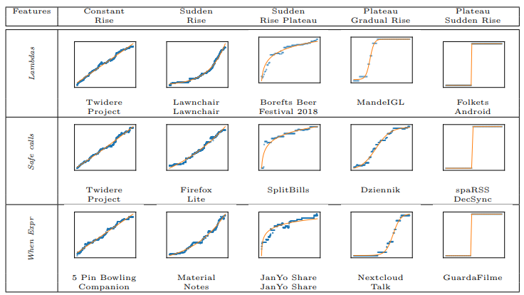
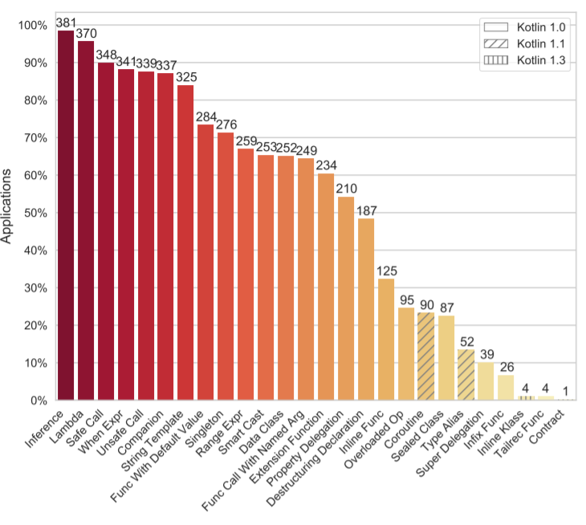

Slide 4


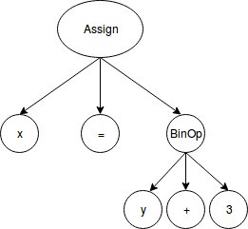
Two keypoints
AST

Slide 5
Recall on AST
x = y + 3
⬄

Slide 6
Visitor example
func visit(_ stmt: ClosureExpression) throws -> Bool {
count += 1
return true
}

Slide 7
Github exploration
Maybe some tools already exist
Data will be biased

Slide 8
Sources
Mateus, Bruno Góis, et Matias Martinez. « On the Adoption, Usage and Evolution of Kotlin Features on Android Development ». ArXiv:1907.09003 [Cs], 20 janvier 2020. http://arxiv.org/abs/1907.09003.

